Slide 1
ECE 322L
Electronics 2
04/02/20 - Lecture 19
Gain-bandwidth product
Augmented π model for a MOSFET
Frequency response of MOSFETs and BJTs

Slide 2
Updates and overview
Midterm 2 next week. Please see the announcement on UNM Learn.
Today
Gain-bandwidth product in different amplifier configurations
High frequency model of a MOSFET
High frequency response of a MOSFET based amplifier
Intrinsic frequency response of BJTs and MOSFETs
4/2/2020

Slide 3
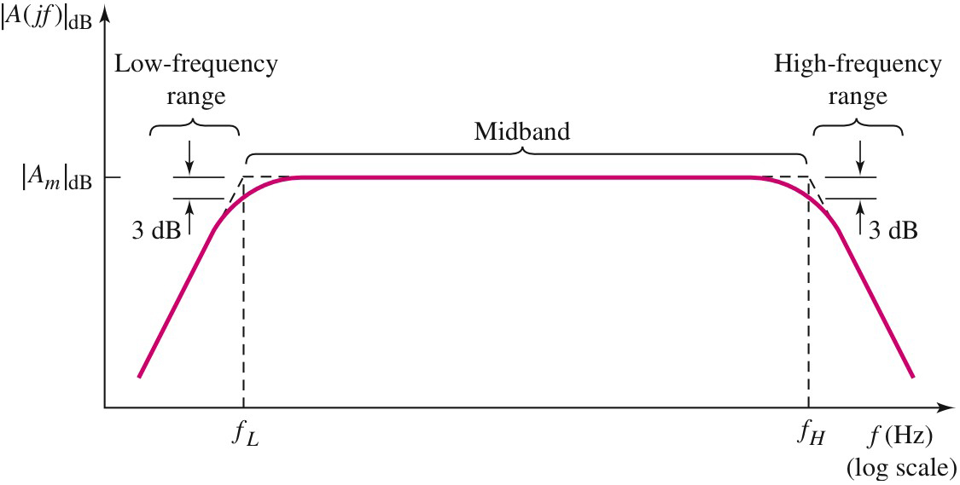


Gain-bandwidth product (GB or GBW)
GBW is a figure of merit of amplifiers
A high GBW is desirable
4/2/2020

Slide 4
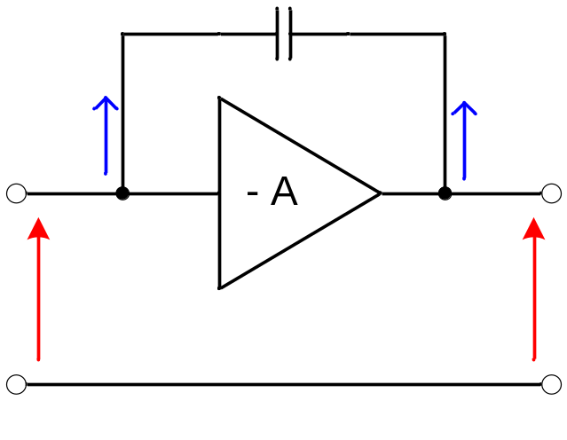
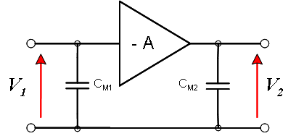
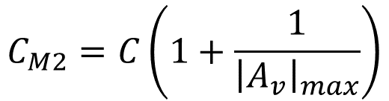


GBW and Miller effect
The Miller effect associated to the capacitors between the input and the output limits performance of amplifiers in CE configuration.
C
I₁
I₂
V₁
V₂
Any increase of the GBW is hindered by the Miller effect
4/2/2020

Slide 5
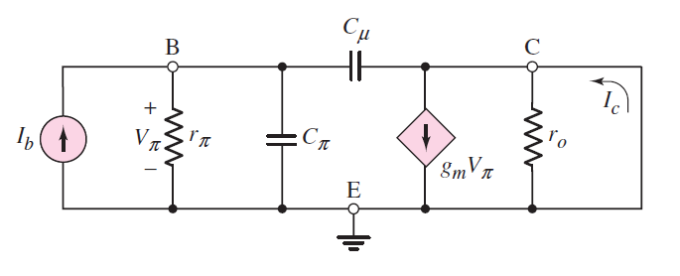
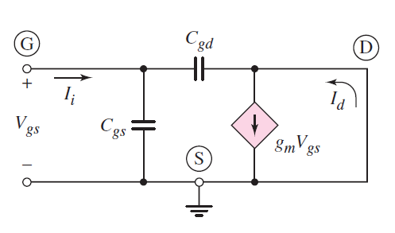
Strategies to increase the GBW
Reduce the capacitance between input and output which can be achieved by reducing the area of the B-C junction.
Use a different amplifier configuration.
4/2/2020

Slide 6
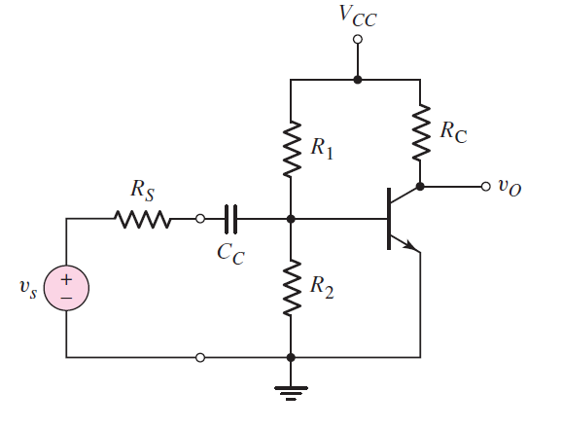
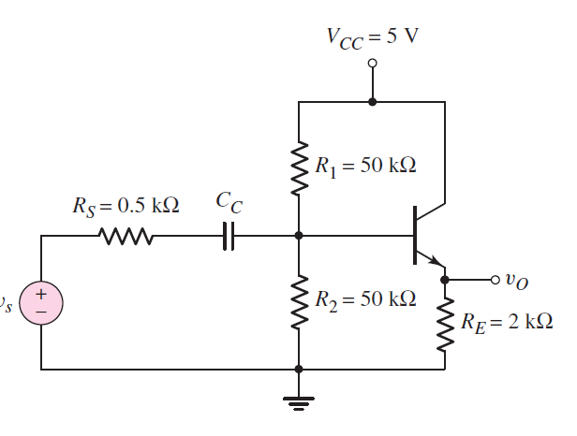
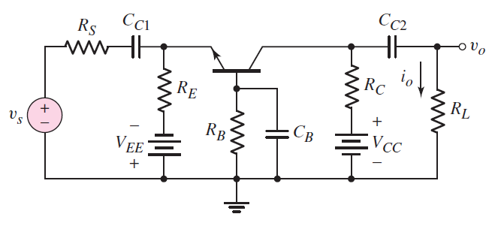
Miller effect in CE, CB, and CC amplifiers
*See handout on UNM Learn (Lecture 19 folder)
4/2/2020

Slide 7
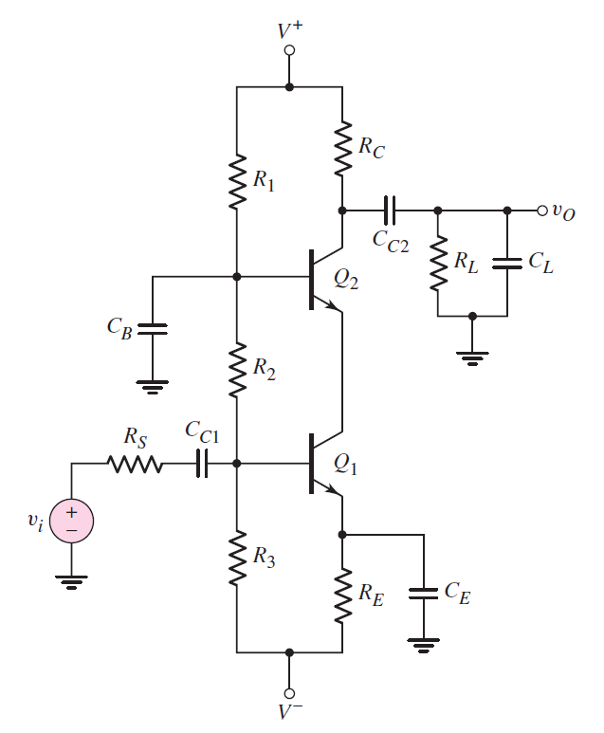
Cascode circuit
High input impedance
High gain
High bandwidth
*See the two handouts about the cascode on UNM learn (Lecture 19 folder)
4/2/2020

Slide 8
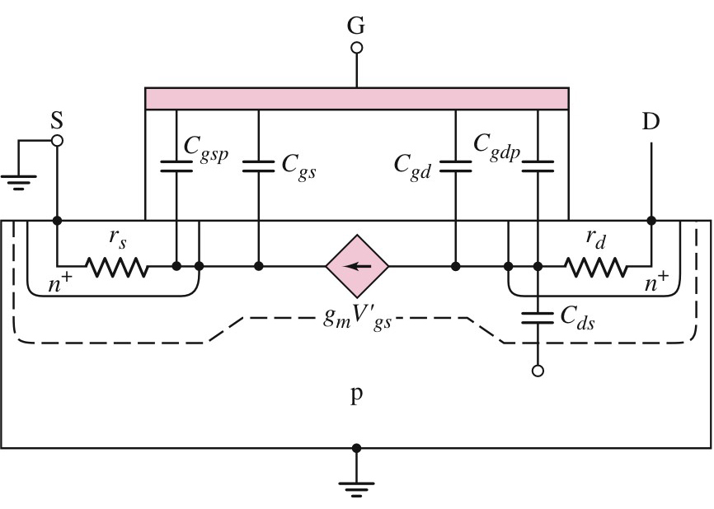
Inherent Resistances and Capacitances in an NMOS
S’
D’
Two types of capacitive effects are inherent to a MOSFET:
the gate capacitive effect
the junction capacitive effect at the source-body and at the drain-body terminals
4/2/2020

Slide 9
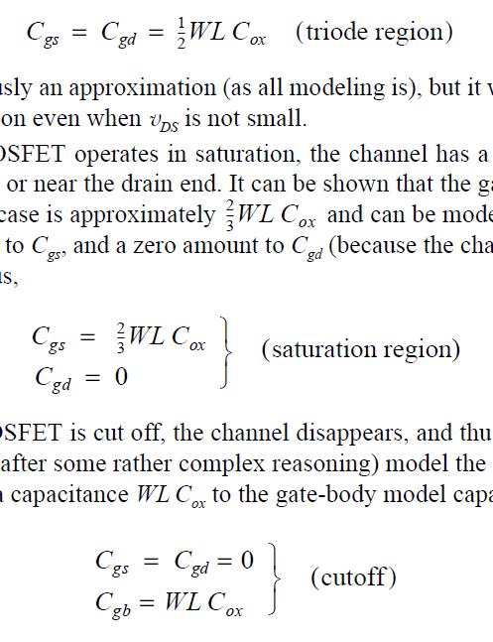


The gate capacitive effect
The gate electrode forms a parallel-plate capacitor with the channel, the source and the drain, with the oxide layer serving as the capacitor dielectric.
The gate capacitive effect is modeled by four capacitances:
C_{gs}, C_{gd}, C_{gsp}, C_{gdp}.
C_{gs}, C_{gd} describe variation of charges in the channel region in response to the applied V_{g}.
Capacitance between the gate electrode and a channel with uniform width from S to D
Capacitance between the gate electrode and a channel with non-uniform width from S to D
C_{gsp}, C_{gdp} or C_{ov}: parasitic capacitances due to fabrication issues.
Capacitance between the gate electrode and the source and drain S to D
4/2/2020

Slide 10
The junction capacitive effect
The junction capacitive effect is associated with the reverse biased junctions between the source (S) and the body (B) and the drain (D) and the body.
The junction capacitive effect can be modeled by the two capacitances:
C_{sb} and C_{db}.
C_{sb}, C_{db} describe variation of fixed charge density at the S-B and D-B junctions in response to the applied v_{g}.
Often S and B are at the same potential. In that scenario the impedance associated with C_{sb} is zero and C_{db} is also indicated as C_{ds}.
4/2/2020

Slide 11
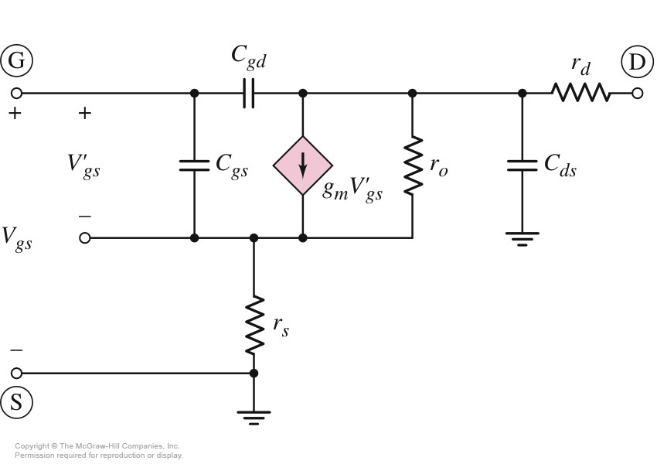
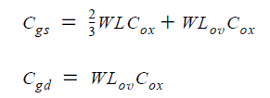
Equivalent Circuit for an Common Source NMOS
Simplified model
Note that C_{gs} and C_{gd} include C_{gsp} and C_{gdp.}
4/2/2020

Slide 12
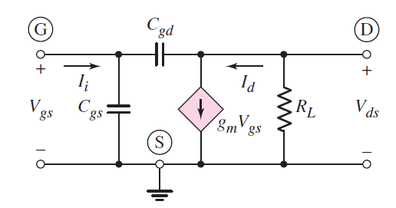
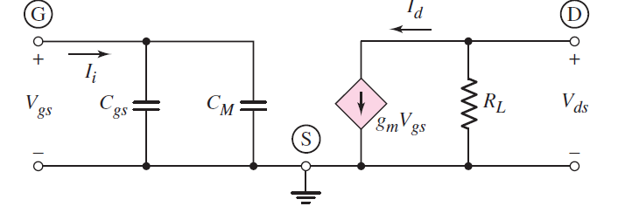

Miller effect
Note that the Miller capacitance at the output can be neglected as it is very small.
4/2/2020

Slide 13
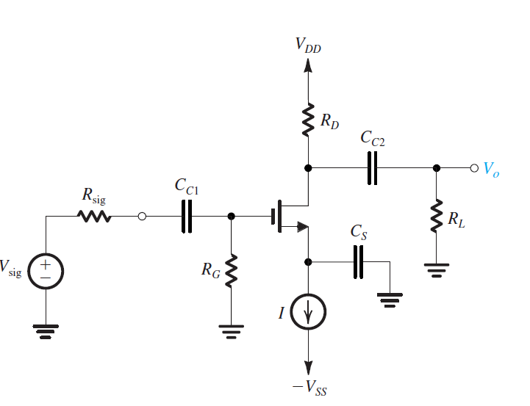
Lecture 19-In class problem
Determine expressions for all the upper corner frequencies of the circuit below
4/2/2020

Slide 14
Intrinsic frequency response of a BJT
How does one assess the intrinsic frequency response of a BJT?
By evaluating
its short circuit current gain vs frequency
its cut-off frequency or unity current gain frequency.
4/2/2020

Slide 15
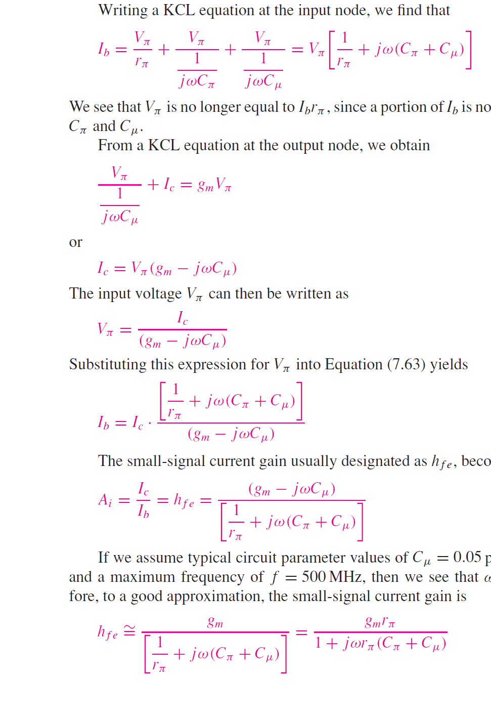
Intrinsic frequency response of a BJT
KCL at B
(1)
KCL at C
(2)
Plugging the expression obtained for V_{π} in eq. (1) yields
4/2/2020

Slide 16
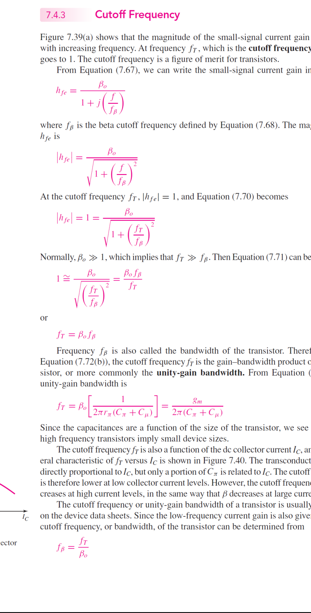
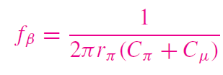
Intrinsic frequency response of a BJT
Hence the short circuit current gain for a BJT is
If we assume typical circuit parameter values of C_{μ}=0.05 pF, g_{m}=50 mA/V, and a maximum frequency of f=500 MHz, then we see that ωC_{μ}<<g_{m}. Therefore,
or
4/2/2020

Slide 17
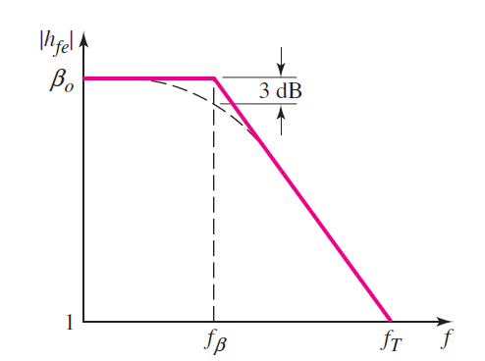


Intrinsic frequency response of a BJT
The internal capacitances of the BJT leads to a low pass response
The cut-off frequency of the transistor is the frequency which yields a unity short-circuit current gain.
4/2/2020

Slide 18
Intrinsic frequency response of a BJT
The internal capacitances of the BJT leads to a low pass response
The cut-off frequency of the transistor is the frequency which yields a unity short-circuit current gain.
4/2/2020

Slide 19
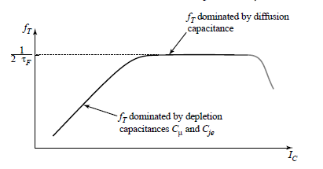


Intrinsic frequency response of a BJT
4/2/2020

Slide 20
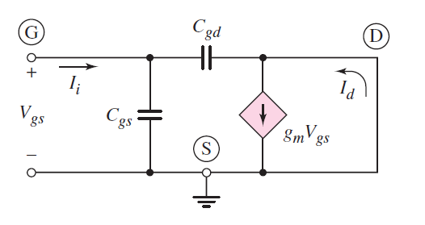
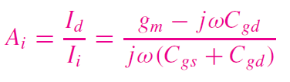
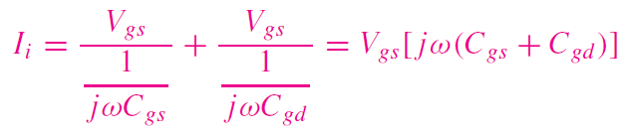
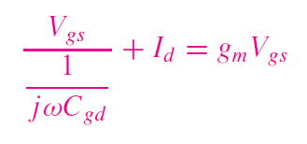
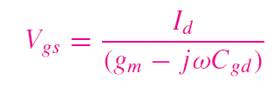

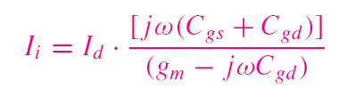
Intrinsic frequency response of NMOS
KCL at G
(1)
KCL at D
(2)
Plugging the expression obtained for V_{gs} in eq. (1) yields
4/2/2020

Slide 21

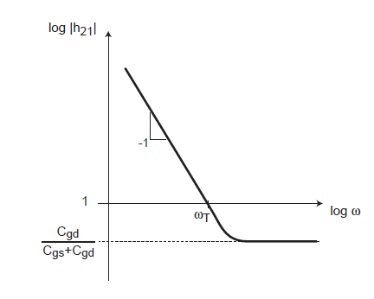


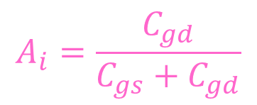
Intrinsic frequency response of NMOS
If we assume typical circuit parameter values of C_{gd}=10 fF, g_{m}=1 mA/V, and a maximum frequency of f=1 GHz, then we see that ωC_{gd}<<g_{m}. There fore,
The internal capacitances of the NMOS lead to a low-pass response
or
At very high frequencies ωC_{gd}>>g_{m} and
4/2/2020

Slide 22
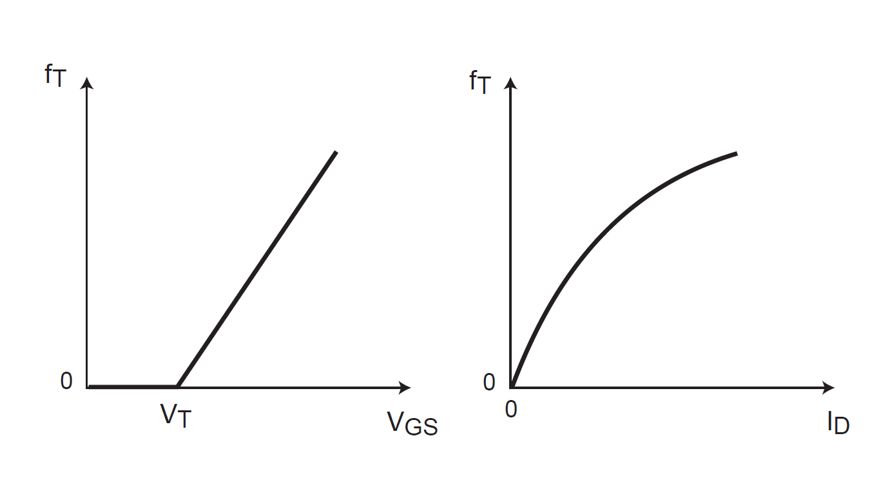
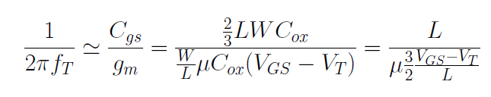
Intrinsic frequency response of NMOS
f_{T} depends on
transistor biasing
mobility
channel length
Overlap length between the gate with the source and drain
4/2/2020

Slide 23
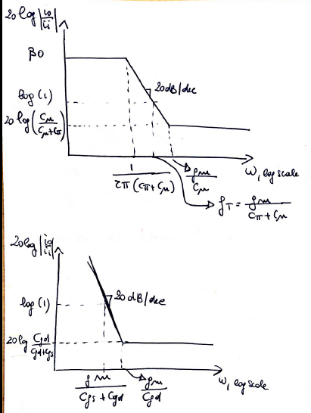
BJT vs MOSFET
BJT
MOSFET
BJTs have larger parasitic capacitances than FETs (~pF vs fF).
BJTs have much larger transconductance than FETs.
Therefore, the gain-bandwidth product of bipolar amplifiers is usually larger than that of comparable FET amplifiers.
*See the three handouts that I previously posted on BJT vs. MOSFETS on UNM Learn (Handout folder)
4/2/2020

